Slide 1

Department of CSE-AI & ML (CSM)
Team:BATCH13
21BQ1A42I2, 21BQ1A42F4,
21BQ1A42D5, 21BQ1A42H9
Project Title:
AI-BASED VIDEO INSIGHTS GENERATOR
TEAM MEMBERS:
21BQ1A42I2 – :Y. Bindu Varsha
21BQ1A42F4 – :P. Sambasivarao
21BQ1A42D5 –:P. Snehal Kumar
21BQ1A42H9 –::V. Charan Sai Venkat
Under the Guidance of:
(Project Guide) HOD-CSM,
Mr. SK Wasim Akram Dr. K. Suresh Babu

Slide 2
Department of CSE-AI & ML (CSM)
Team:BATCH13
21BQ1A42I2, 21BQ1A42F4,
21BQ1A42D5, 21BQ1A42H9
Abstract
This project, AI-BASED VIDEO INSIGHTS GENERATOR, focuses on extracting key themes from textual and video data using deep learning techniques. The system integrates LSTM-based classification for theme detection and transformer-based summarization to generate concise content summaries.
The platform processes videos from YouTube, Google Drive, and local uploads, converting speech to text and extracting timestamps for better contextual understanding. The system also supports multilingual translation and an interactive Q&A module, allowing users to query video content dynamically.
Utilizing LSTM, Conv1D, MaxPooling1D, and BatchNormalization layers, the model effectively classifies themes, while transformer models like T5, Pegasus, and BART generate high-quality summaries. Additionally, it incorporates speech-to-text transcription, API-based translations, and evaluation metrics to assess performance.
This project provides an efficient way to analyze long-form video content, enhancing accessibility and understanding. The implementation is optimized with EarlyStopping and ModelCheckpoint to ensure high accuracy and efficiency.

Slide 3
Department of CSE-AI & ML (CSM)
Team:BATCH13
21BQ1A42I2, 21BQ1A42F4,
21BQ1A42D5, 21BQ1A42H9
Project Overview
The " AI-BASED VIDEO INSIGHTS GENERATOR " is an advanced deep learning system designed to automatically analyze and extract meaningful themes from both textual and video content. The project leverages LSTM-based models for theme classification and transformer-based architectures for text summarization, providing an efficient way to process and summarize large volumes of data. It supports multiple video sources, including YouTube, Google Drive, and local uploads, converting spoken content into structured text while maintaining key timestamps for reference.
The system integrates speech-to-text transcription, multilingual translation, and an interactive Q&A feature, allowing users to engage with content dynamically. Using LSTM, Conv1D, MaxPooling1D, and BatchNormalization layers, the classification model detects themes with high accuracy, while summarization is handled by transformer models such as T5, Pegasus, and BART. Performance optimizations like EarlyStopping and ModelCheckpoint ensure efficient training, while evaluation metrics help assess the system’s accuracy and reliability. This project serves as a powerful tool for extracting key insights from long-form video and text content, making information more accessible and structured.

Slide 4
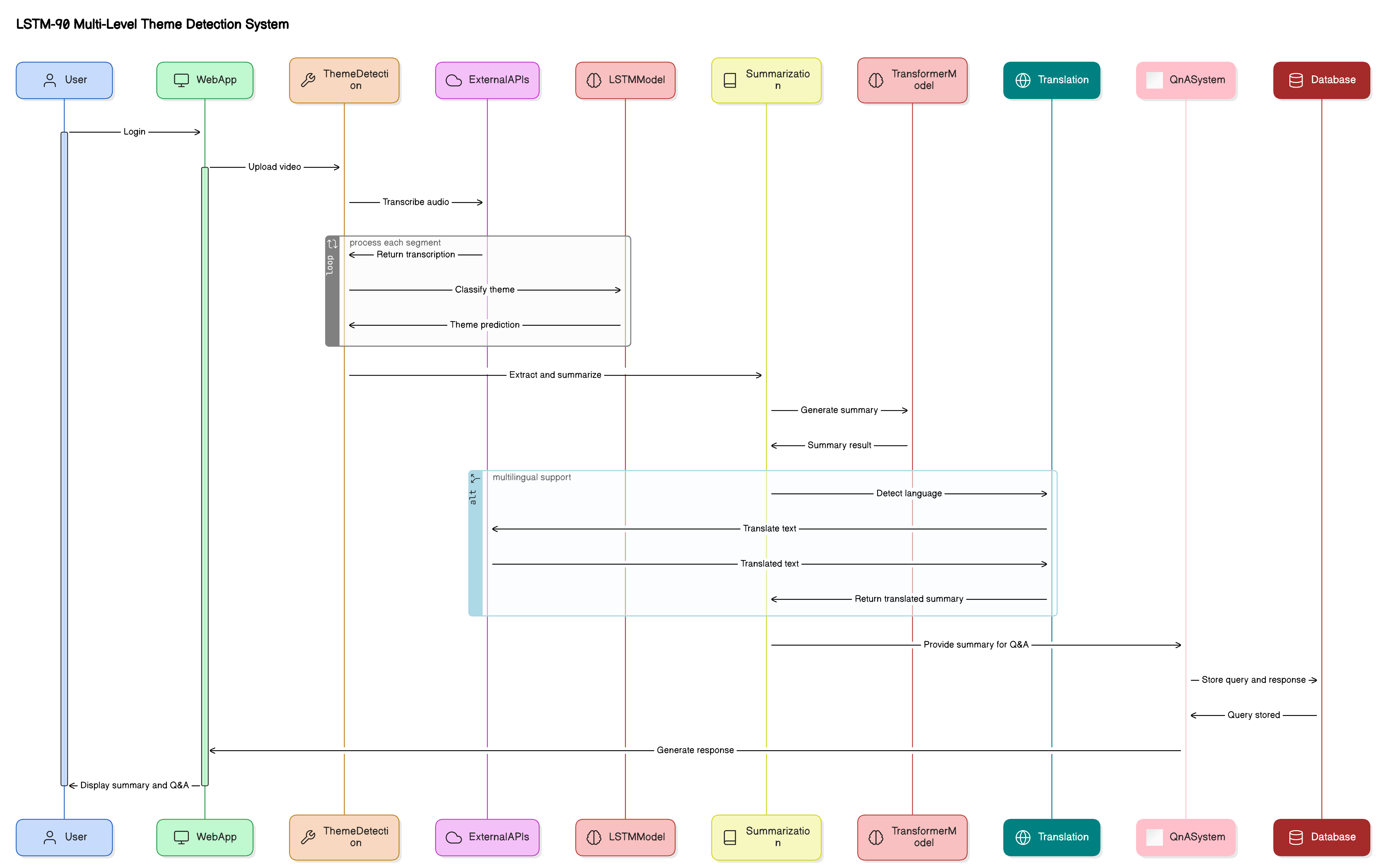
Department of CSE-AI & ML (CSM)
Team:BATCH13
21BQ1A42I2, 21BQ1A42F4,
21BQ1A42D5, 21BQ1A42H9
System Architecture

Slide 5
Department of CSE-AI & ML (CSM)
Team:BATCH13
21BQ1A42I2, 21BQ1A42F4,
21BQ1A42D5, 21BQ1A42H9
Proposed System
Proposed System
The proposed system AI-BASED VIDEO INSIGHTS GENERATOR, is designed to provide an automated, intelligent, and scalable solution for theme detection and summarization. It processes both textual and video content, extracting key themes and generating concise summaries using LSTM-based models and transformer architectures. The system integrates speech-to-text transcription, timestamp extraction, and multilingual translation, ensuring comprehensive content analysis. The inclusion of an interactive Q&A feature allows users to query specific topics within the processed data, making the system more user-friendly and efficient.
To enhance accuracy and efficiency, the system employs Conv1D, MaxPooling1D, and BatchNormalization layers in theme detection and uses T5, Pegasus, and BART models for summarization. The model is optimized through EarlyStopping and ModelCheckpoint, ensuring reduced processing time while maintaining high accuracy. The backend is powered by TensorFlow and PyTorch, while APIs handle video transcription and multilingual translation. This solution effectively bridges the gap between unstructured video data and structured, meaningful insights, making it a valuable tool for researchers, content analysts, and information retrieval systems.

Slide 6
Department of CSE-AI & ML (CSM)
Team:BATCH13
21BQ1A42I2, 21BQ1A42F4,
21BQ1A42D5, 21BQ1A42H9
System Features
Multi-Level Theme Detection:
Extracts themes from both video and text sources.
Uses LSTM, Conv1D, and MaxPooling1D for classification.
Supports timestamp extraction for precise content mapping.
Advanced Summarization:
Utilizes T5, Pegasus, and BART for transformer-based summarization.
Generates concise summaries of long-form content.
Speech-to-Text Transcription:
Converts video/audio into structured text.
Supports multiple video sources (YouTube, Google Drive, local files).

Slide 7
Department of CSE-AI & ML (CSM)
Team:BATCH13
21BQ1A42I2, 21BQ1A42F4,
21BQ1A42D5, 21BQ1A42H9
Interactive Q&A System:
Users can ask queries about the processed content.
AI-driven responses provide contextual insights.
Multilingual Translation:
Converts extracted text into multiple languages.
Ensures accessibility for diverse users.
Performance Optimization:
Implements EarlyStopping and ModelCheckpoint to improve training efficiency.
Evaluates accuracy using classification metrics and ROUGE scores.

Slide 8
Department of CSE-AI & ML (CSM)
Team:BATCH13
21BQ1A42I2, 21BQ1A42F4,
21BQ1A42D5, 21BQ1A42H9
Software Requirements
Programming Languages & Frameworks:
Python (for deep learning and AI processing).
TensorFlow & PyTorch (for model implementation).
React (for front-end development).
Node.js (for backend API handling).
Development & Deployment Tools:
Jupyter Notebook (for model training and testing).
Visual Studio Code (for code development).
Google Colab (for cloud-based processing and model execution).
APIs & Libraries Used:
Hugging Face Transformers (for text summarization models: T5, Pegasus, BART).
SpeechRecognition API (for speech-to-text transcription).
YouTube API (for video data extraction).
Google Translate API (for multilingual translation).
Database & Storage:
MongoDB (for storing user data and processed results).
Google Drive (for handling large-scale video storage).

Slide 9
Department of CSE-AI & ML (CSM)
Team:BATCH13
21BQ1A42I2, 21BQ1A42F4,
21BQ1A42D5, 21BQ1A42H9
Hardware Requirements:
Operating System: Windows 10 or above / Linux (for model training and development).
Processor: Intel Core i5/i7 or AMD Ryzen 5/7 (for efficient model execution).
RAM: Minimum 8GB (16GB recommended for handling large video and text datasets).
Storage: At least 1TB HDD or 256GB SSD (for storing video data, transcripts, and model checkpoints).
Graphics Card: Minimum NVIDIA GTX 1050 Ti (recommended RTX 2060 or higher for deep learning acceleration).
Internet Speed: At least 10 Mbps (for fetching data from APIs, cloud storage, and processing video content).

Slide 10
Department of CSE-AI & ML (CSM)
Team:BATCH13
21BQ1A42I2, 21BQ1A42F4,
21BQ1A42D5, 21BQ1A42H9
Results:
Theme Detection Accuracy: The LSTM-based classification model successfully identifies themes from both text and video transcriptions with high accuracy, leveraging Conv1D, MaxPooling1D, and BatchNormalization layers.
Summarization Performance: The pre-trained transformer models (T5, Pegasus, BART) generate concise and meaningful summaries of transcribed content, achieving high ROUGE scores.
Speech-to-Text Efficiency: The system accurately transcribes video/audio content using API-based transcription, providing clear timestamps for extracted themes.
Multilingual Translation: The detected themes and summaries are effectively translated into multiple languages, ensuring broader accessibility.
Interactive Q&A System: Users can ask questions about the video content, receiving relevant answers generated from the transcribed text.
Overall System Performance: The model demonstrates optimized performance with EarlyStopping and ModelCheckpoint, ensuring efficient training and execution.

Slide 11
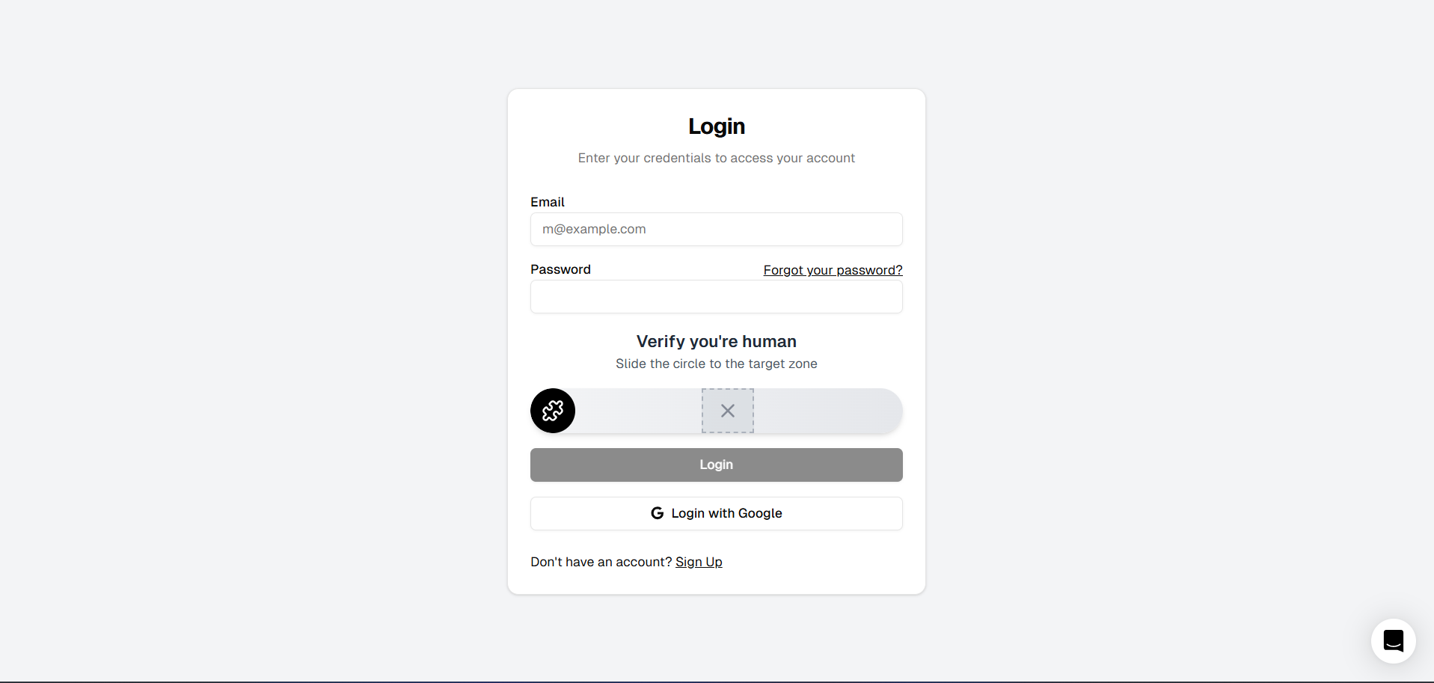
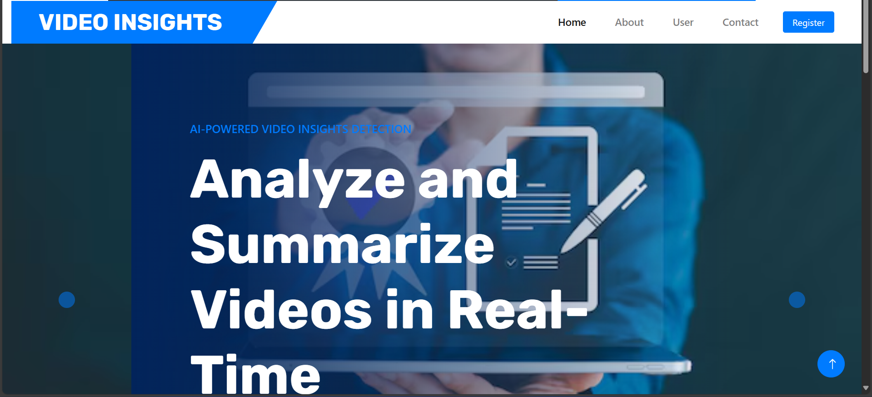
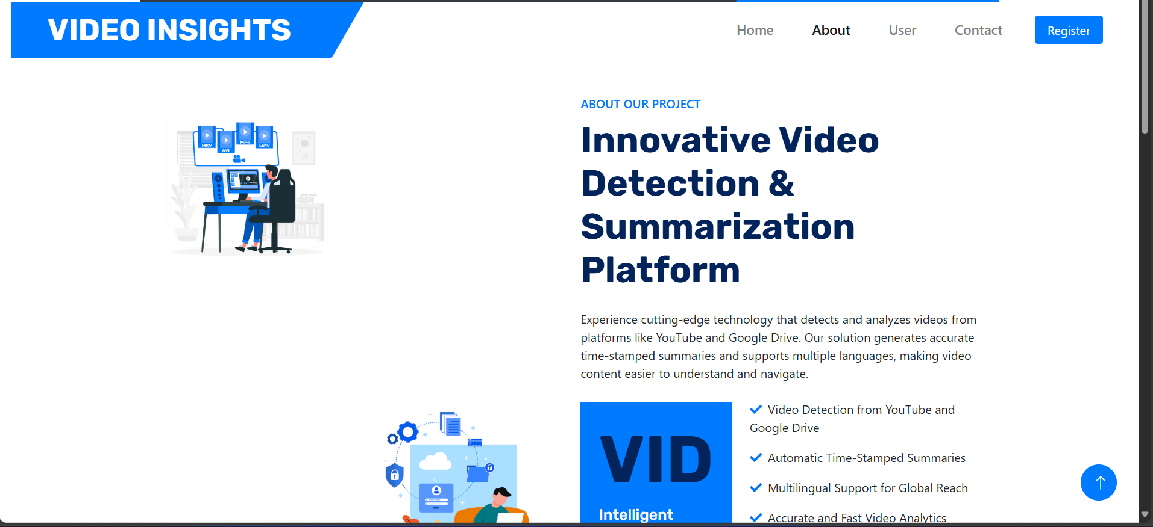
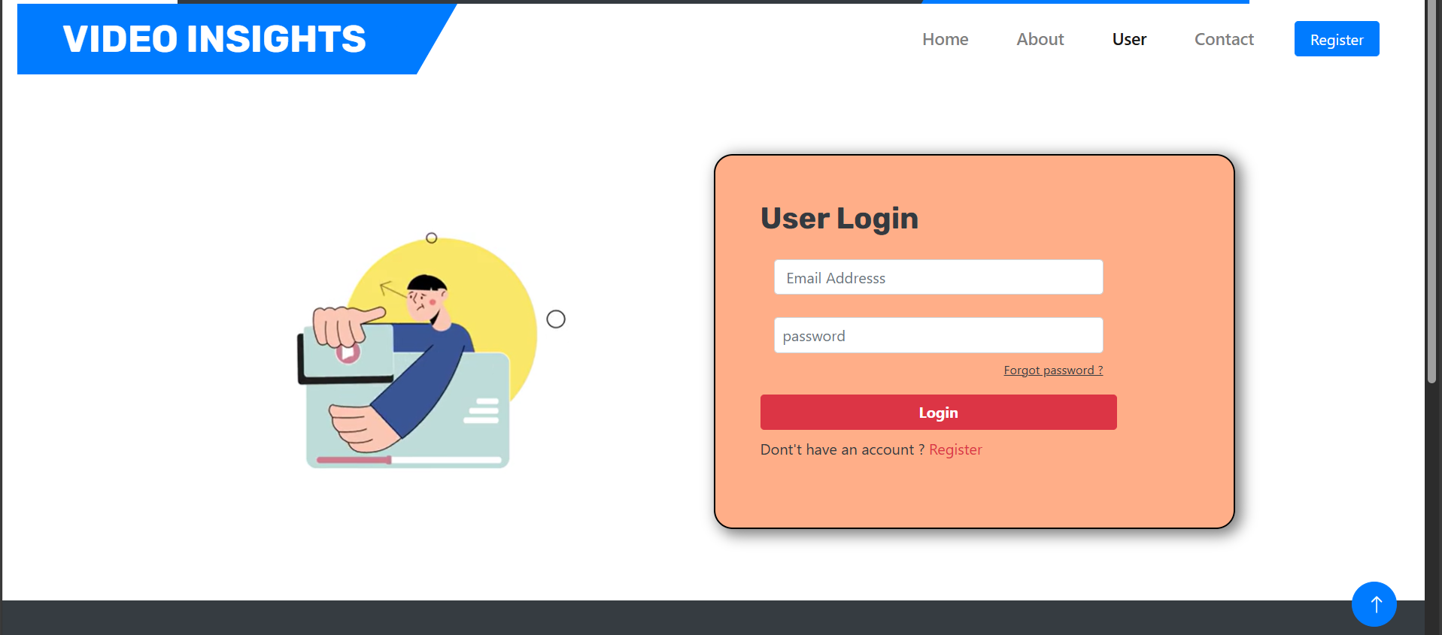
Department of CSE-AI & ML (CSM)
Team:BATCH13
21BQ1A42I2, 21BQ1A42F4,
21BQ1A42D5, 21BQ1A42H9
Results:

Slide 12
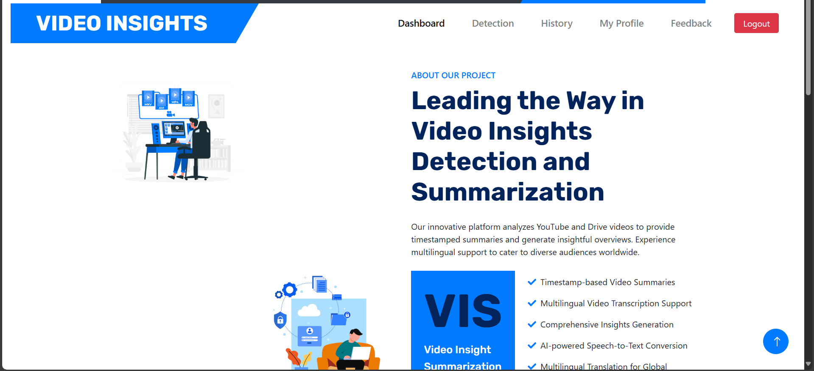
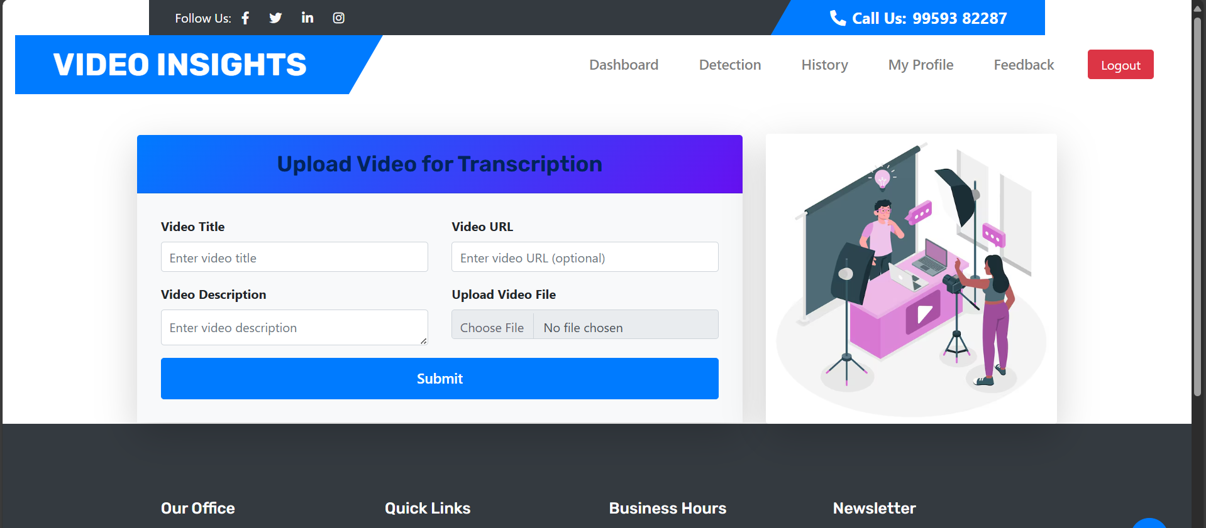
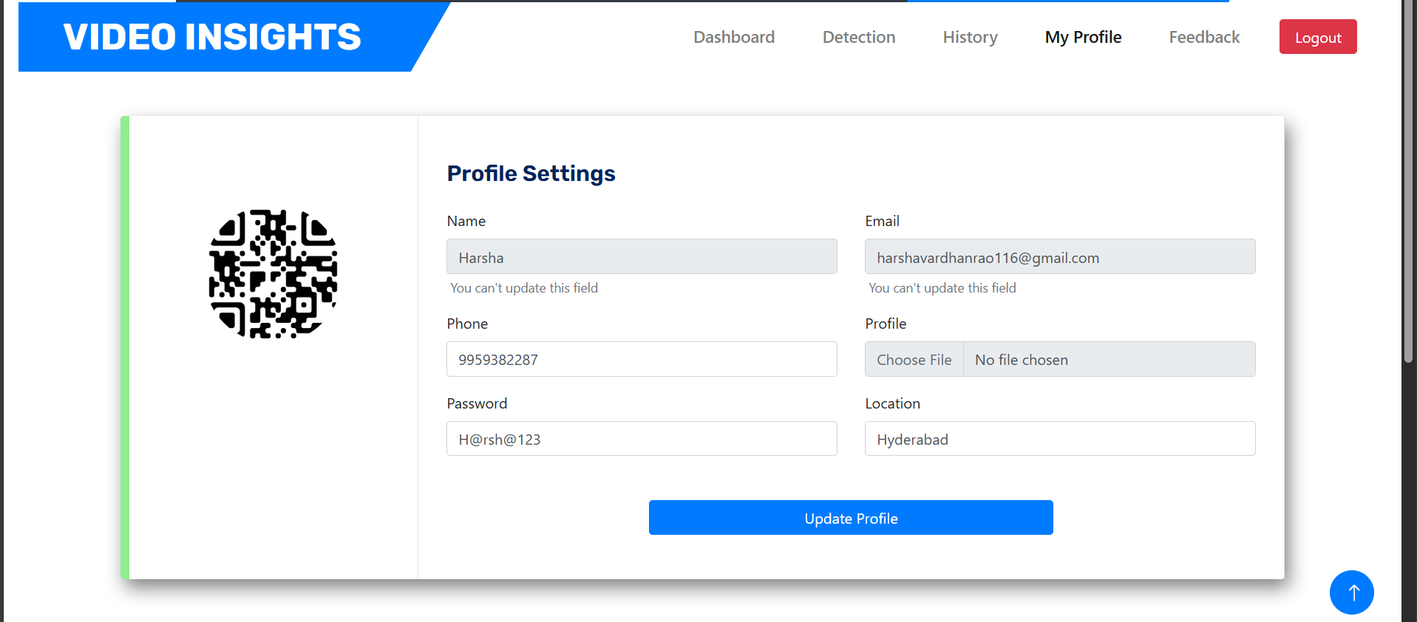

Department of CSE-AI & ML (CSM)
Team:BATCH13
21BQ1A42I2, 21BQ1A42F4,
21BQ1A42D5, 21BQ1A42H9
Results:

Slide 13
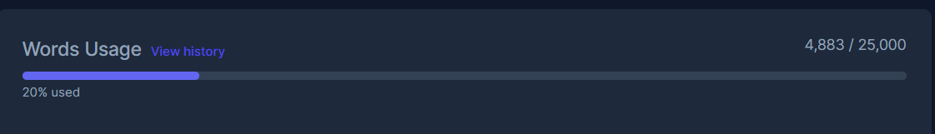
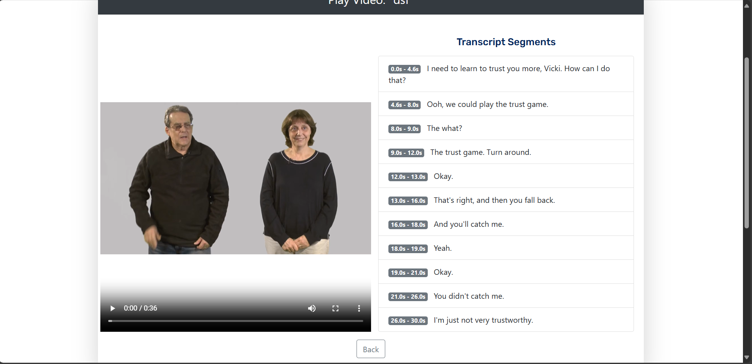
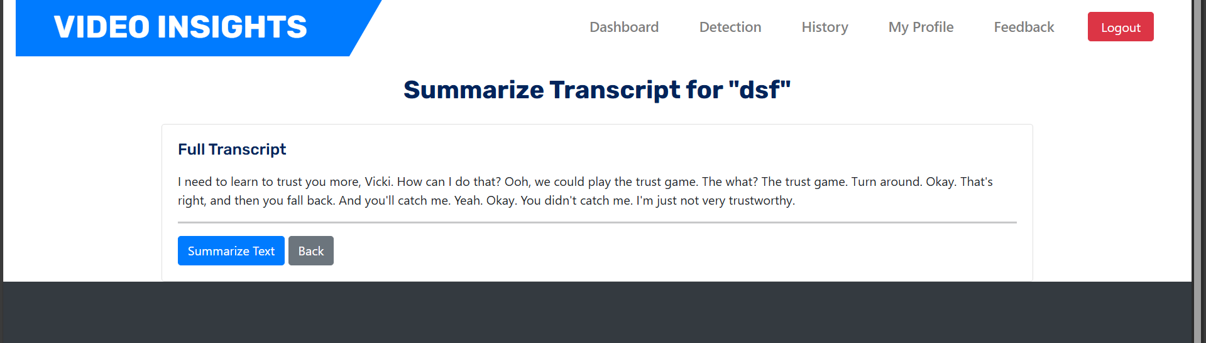

Department of CSE-AI & ML (CSM)
Team:BATCH13
21BQ1A42I2, 21BQ1A42F4,
21BQ1A42D5, 21BQ1A42H9
Results:

Slide 14
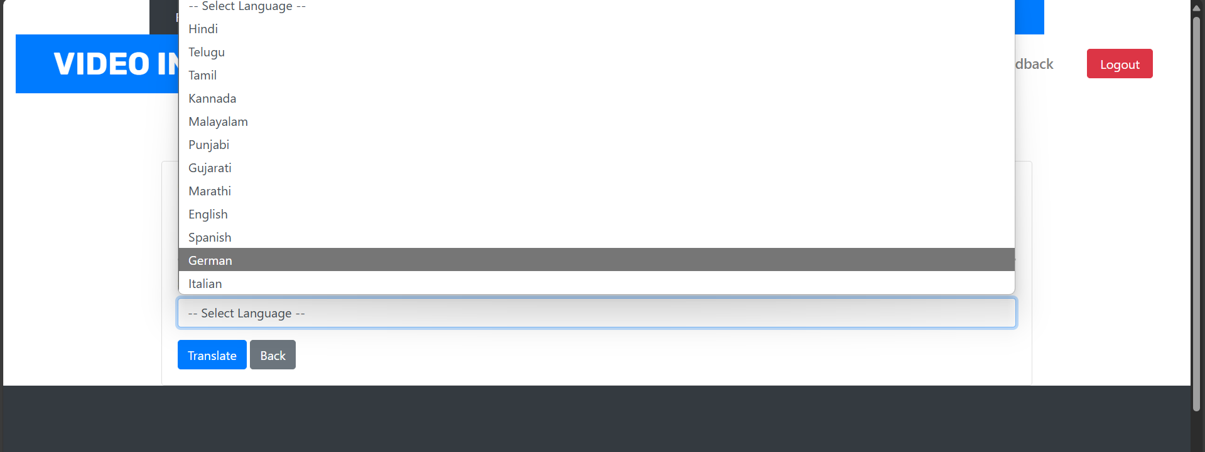
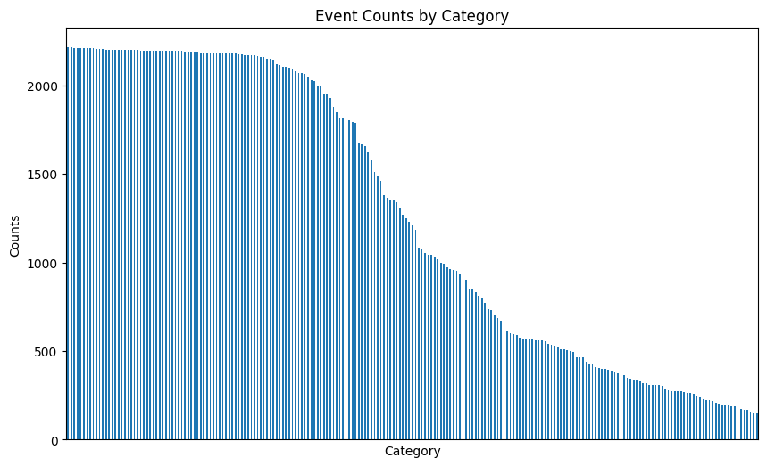
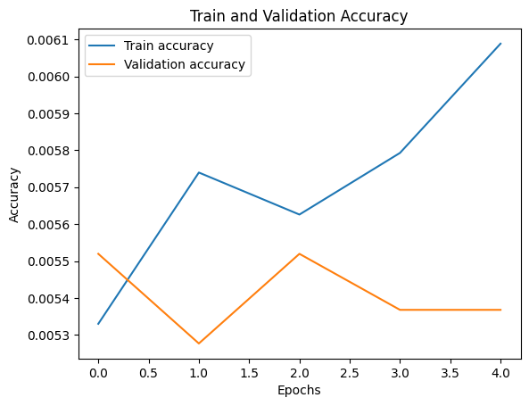
Department of CSE-AI & ML (CSM)
Team:BATCH13
21BQ1A42I2, 21BQ1A42F4,
21BQ1A42D5, 21BQ1A42H9
Results:

